Slide 1
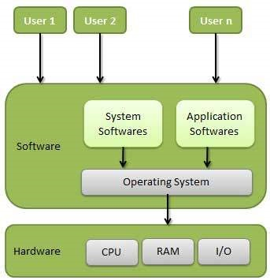
Operating System
An operating system, or "OS," is software that communicates with the hardware and allows other application of the computer to run.

